Slide 1
Capstone: Financial Risk Analysis
Garth Lo Bello — Springboard Capstone Presentation

Slide 2
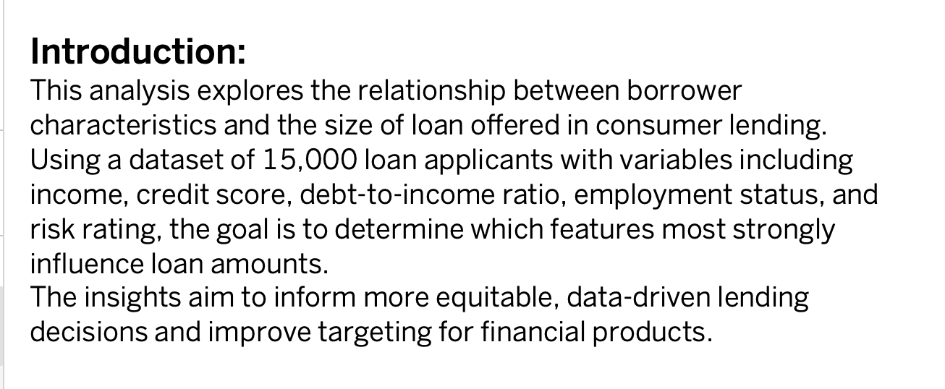
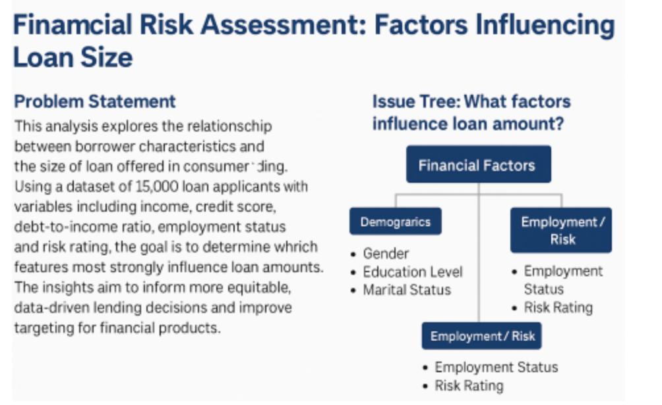
Problem Statement

Slide 3
Executive Summary
• Risk rating, age, and gender had no meaningful impact on loan amounts
• Credit score and employment status showed minimal explanatory power
• DTI (debt to income) had weak but statistically significant correlation (R² < 0.1%)
• Income group and assets did not predict loan size — only volume
• Loan purpose showed minor variation; marital status had no effect

Slide 4
Project Overview
Objective
Data
Goal
Determine whether borrower attributes — such as credit score, income level, employment status, education background, debt-to-income ratio, and demographic variables — have a measurable influence on the loan amount a borrower receives.
The objective is to identify which features are truly driving lending decisions and which ones have negligible or no impact.
The analysis draws on a structured consumer lending dataset composed of thousands of anonymized loan records.
Each record includes borrower-level data such as credit score, annual income, employment status, education level, debt-to-income (DTI) ratio, gender, marital status, risk rating, and more — providing a broad foundation to explore potential correlations and patterns in loan distribution.
Apply statistical analysis and data visualization to identify whether specific borrower characteristics—if any—consistently influence the size of approved loans.”
The ultimate goal is to support smarter, more transparent lending practices that reduce bias, improve targeting, and enhance fairness in credit allocation.

Slide 5
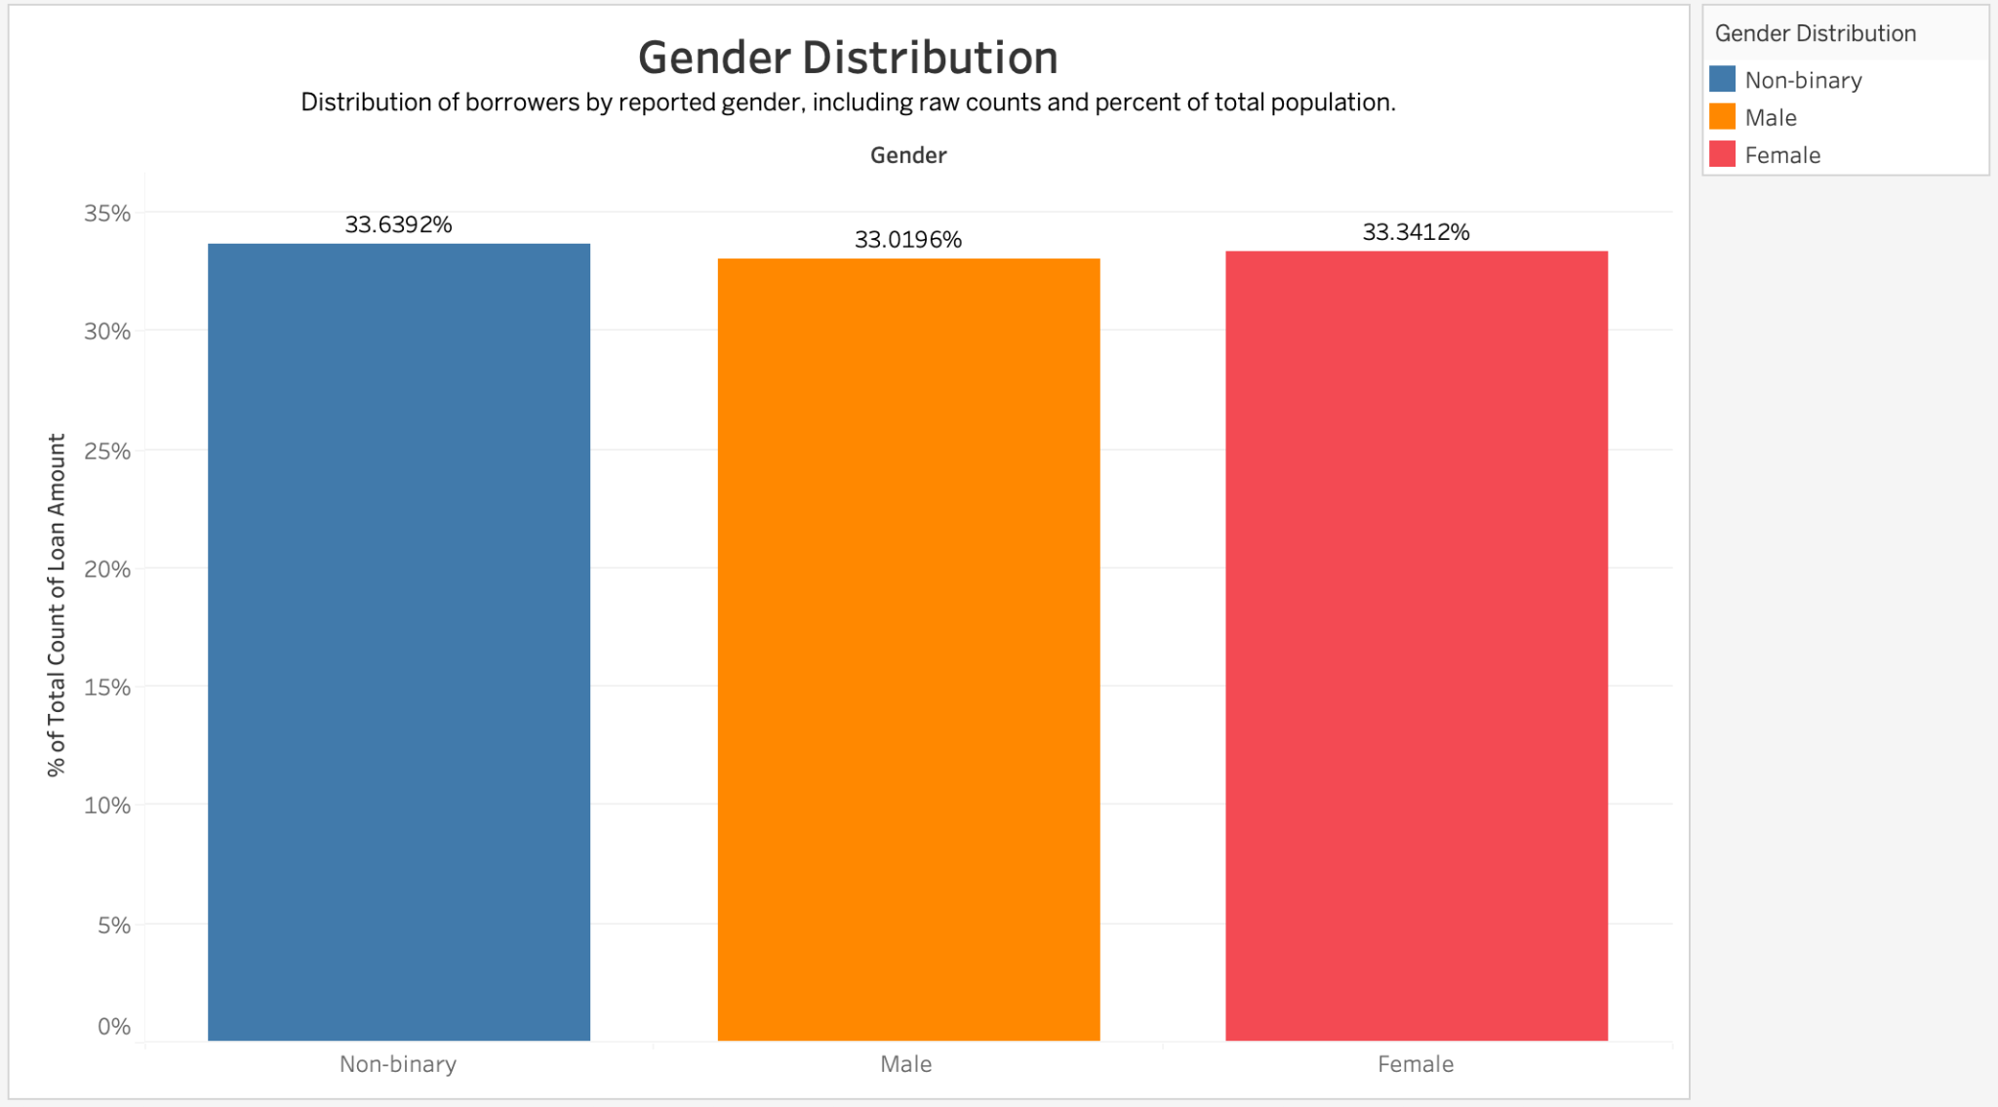
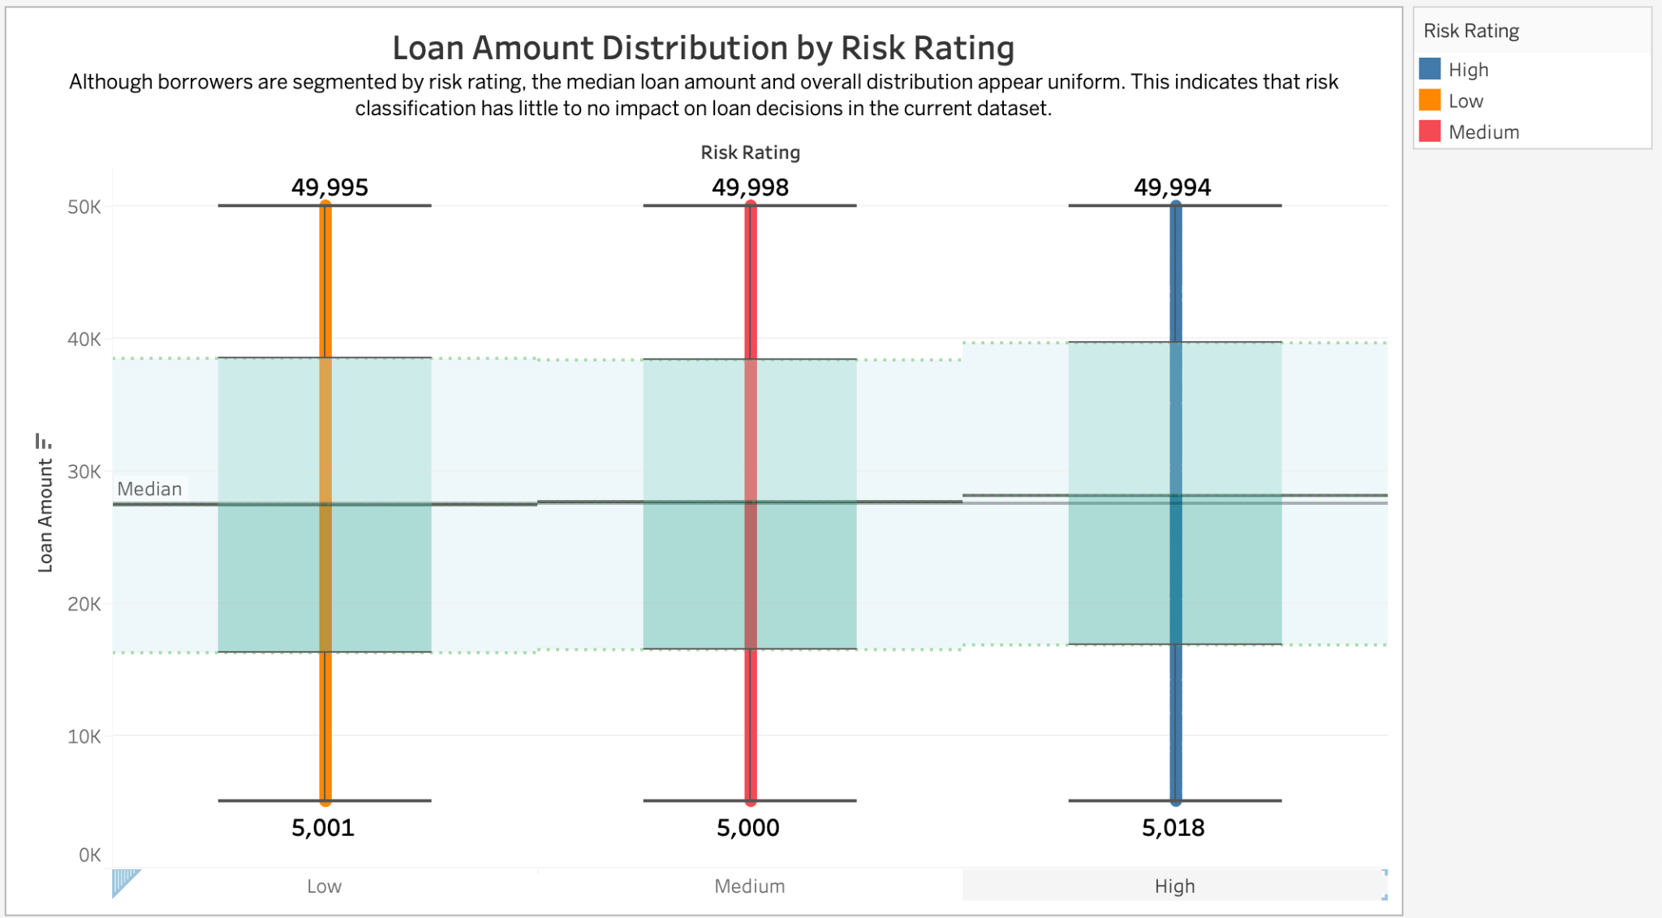
Gender & Risk Rating:
The data reveals that loan amounts are evenly distributed across Male, Female, and Non-binary borrowers, with each group receiving roughly one-third of total loan volume. This suggests there is no systemic bias in loan size based on gender alone.
Separately, we examined the borrower risk classification — categorized as Low, Medium, or High. Surprisingly, we found that risk rating had no measurable effect on the size of loans issued. While we might expect lower-risk borrowers to receive larger loans, the data shows no consistent relationship between risk classification and loan amount.
Neither gender nor internal risk classification significantly influenced loan size. This suggests lending decisions may be more evenly distributed in practice — or that other variables (like income or DTI) may play a larger role in determining loan size.

Slide 6
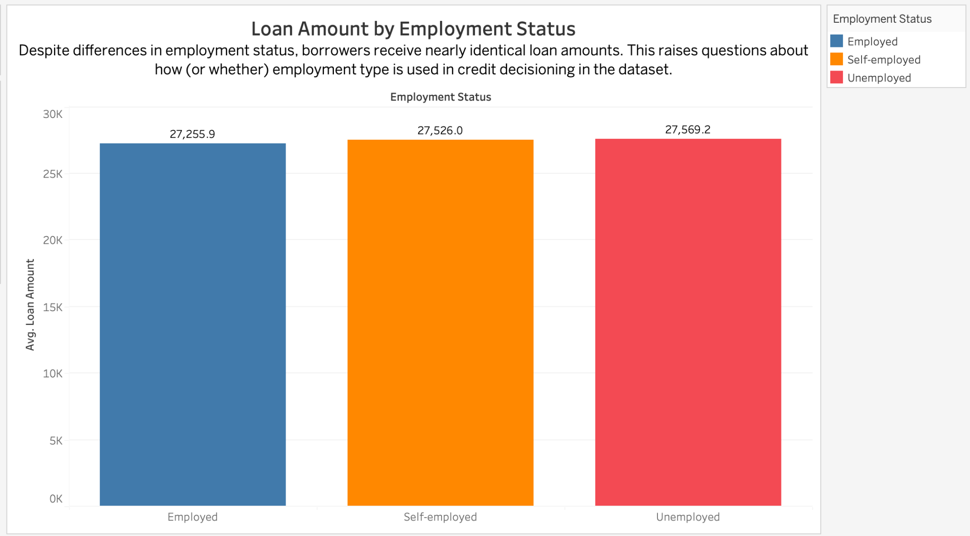
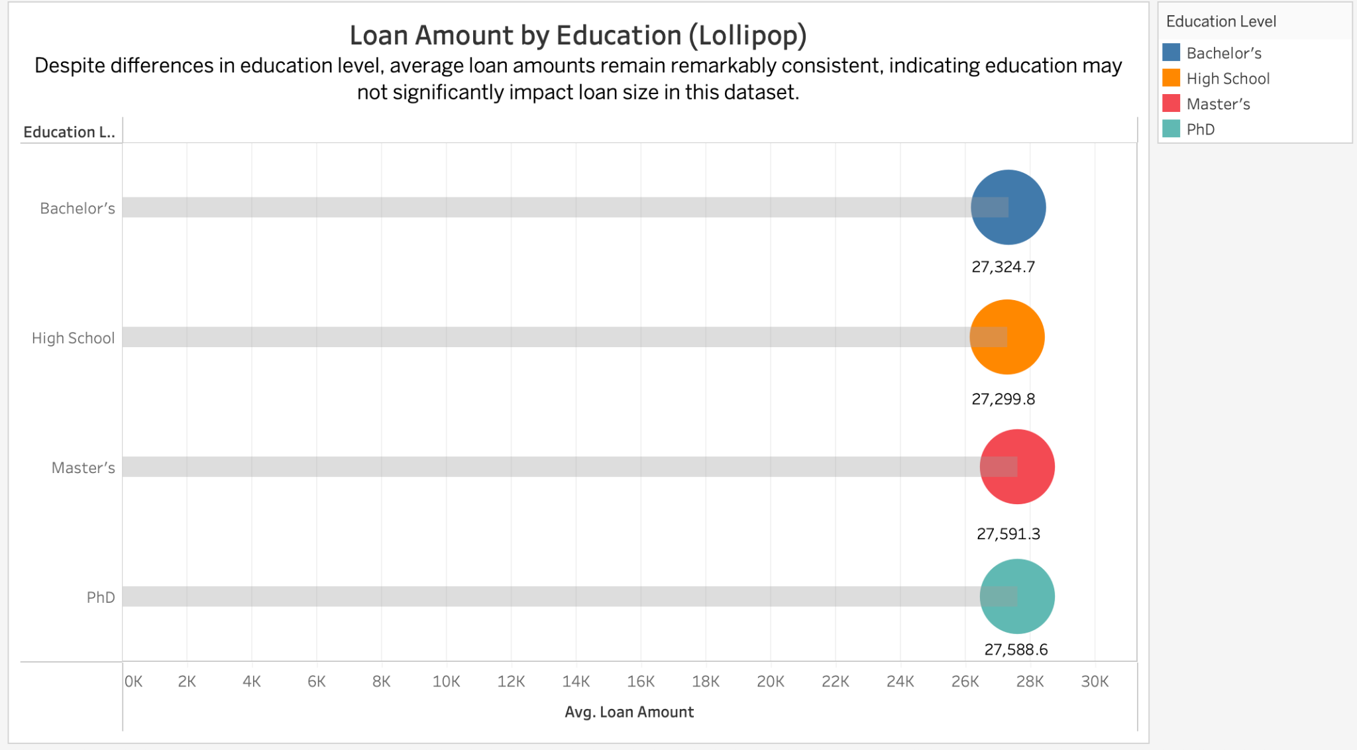
Employment & Education
Loan amounts were remarkably consistent across all employment types — including full-time, part-time, unemployed, retired, and self-employed borrowers. No employment group received significantly higher or lower loan amounts.
Borrowers with higher education levels (e.g., college, graduate school) received slightly higher loan amounts, but the variation was minimal and not predictive.
These graphs tell us that the lending process in this dataset does not appear to favor or penalize borrowers based on employment status. Whether someone is retired or employed full-time, the loan size is generally the same.
Similarly, education seems to have only a marginal impact. People with graduate degrees received slightly higher loans on average, but the differences were too small to drive decision-making.
This suggests that neither employment nor education significantly influences loan allocation — meaning lenders may be relying more heavily on financial indicators like income or credit score instead.”

Slide 7
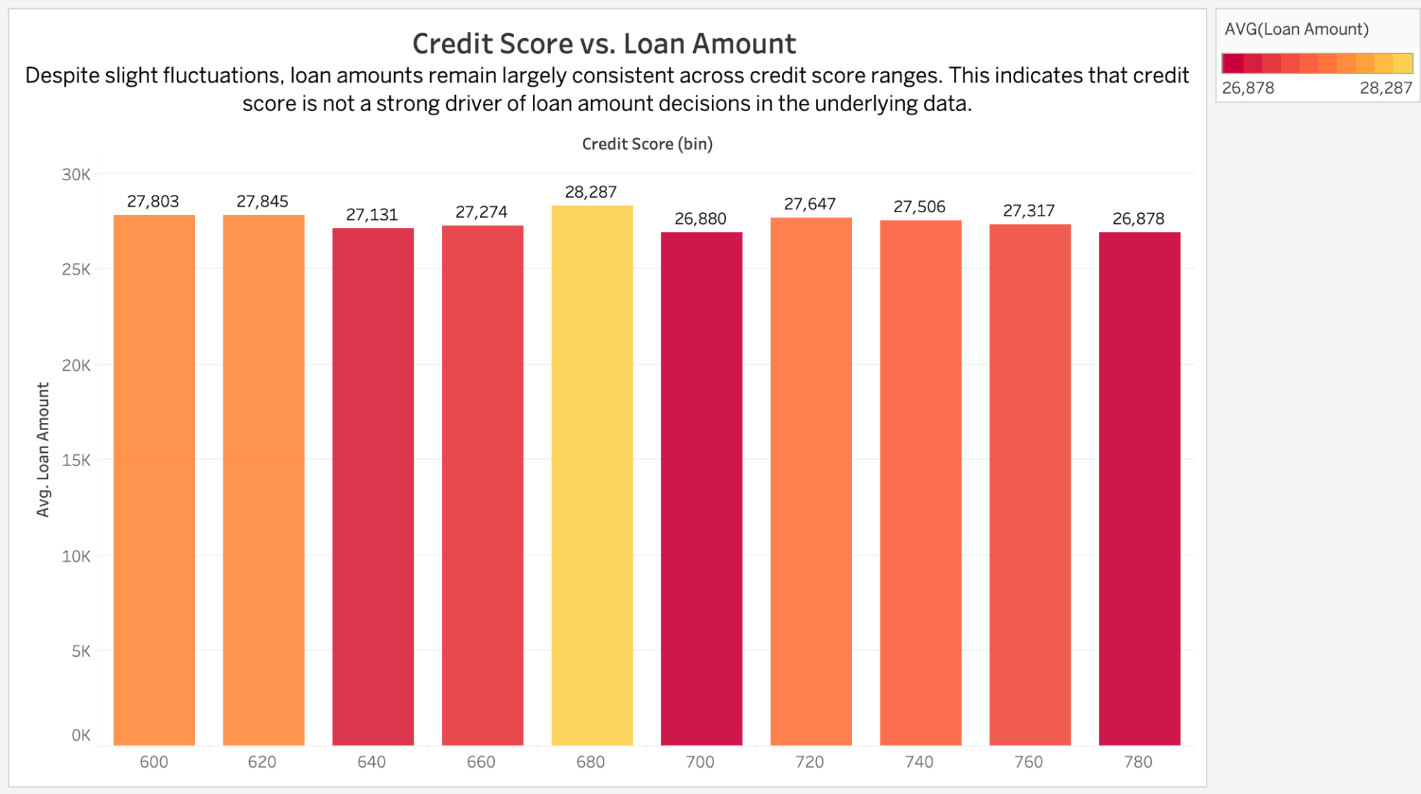
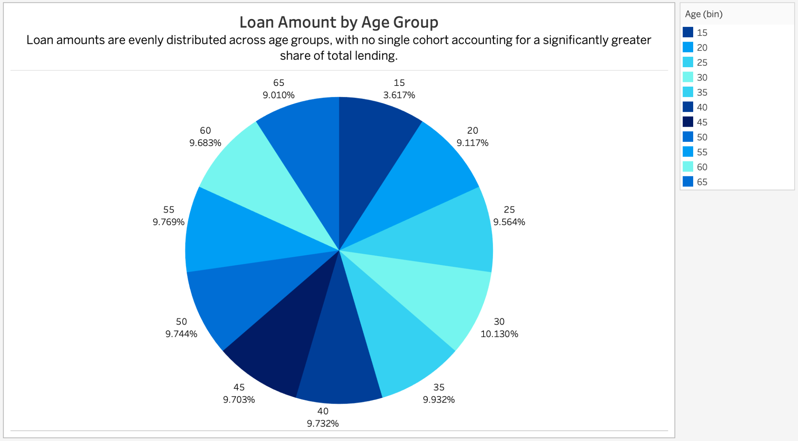
Credit Score & Age
Credit score bins showed no meaningful trend in loan amount. Borrowers across all score categories—from poor to excellent—received loans of similar size, indicating that credit score was not a strong predictor of loan amount in this dataset.
The age distribution of loan recipients was relatively uniform, with each group (from under 25 to over 65) representing 9–10% of total loans. This suggests loans were distributed evenly across age groups, with no evidence of age-related lending bias.

Slide 8
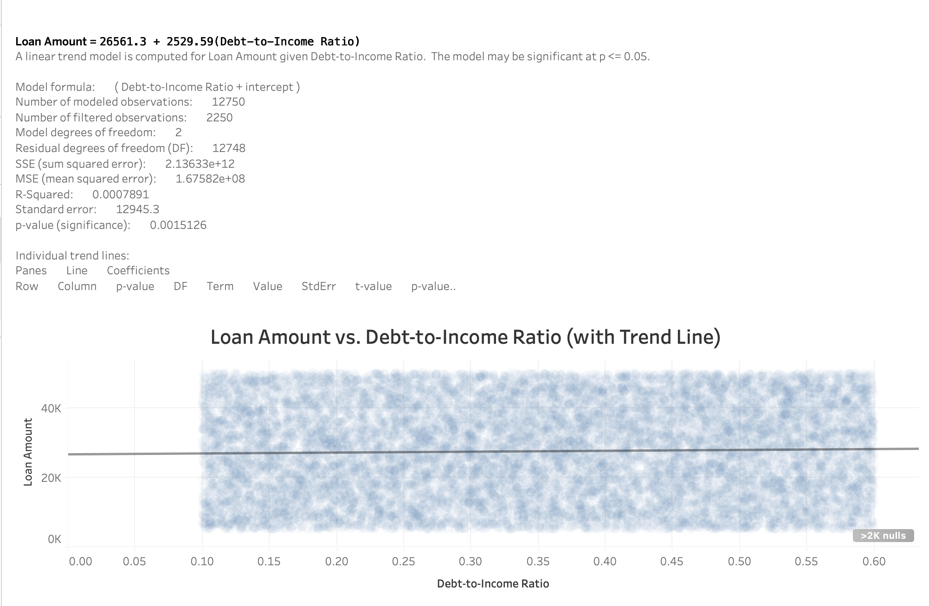
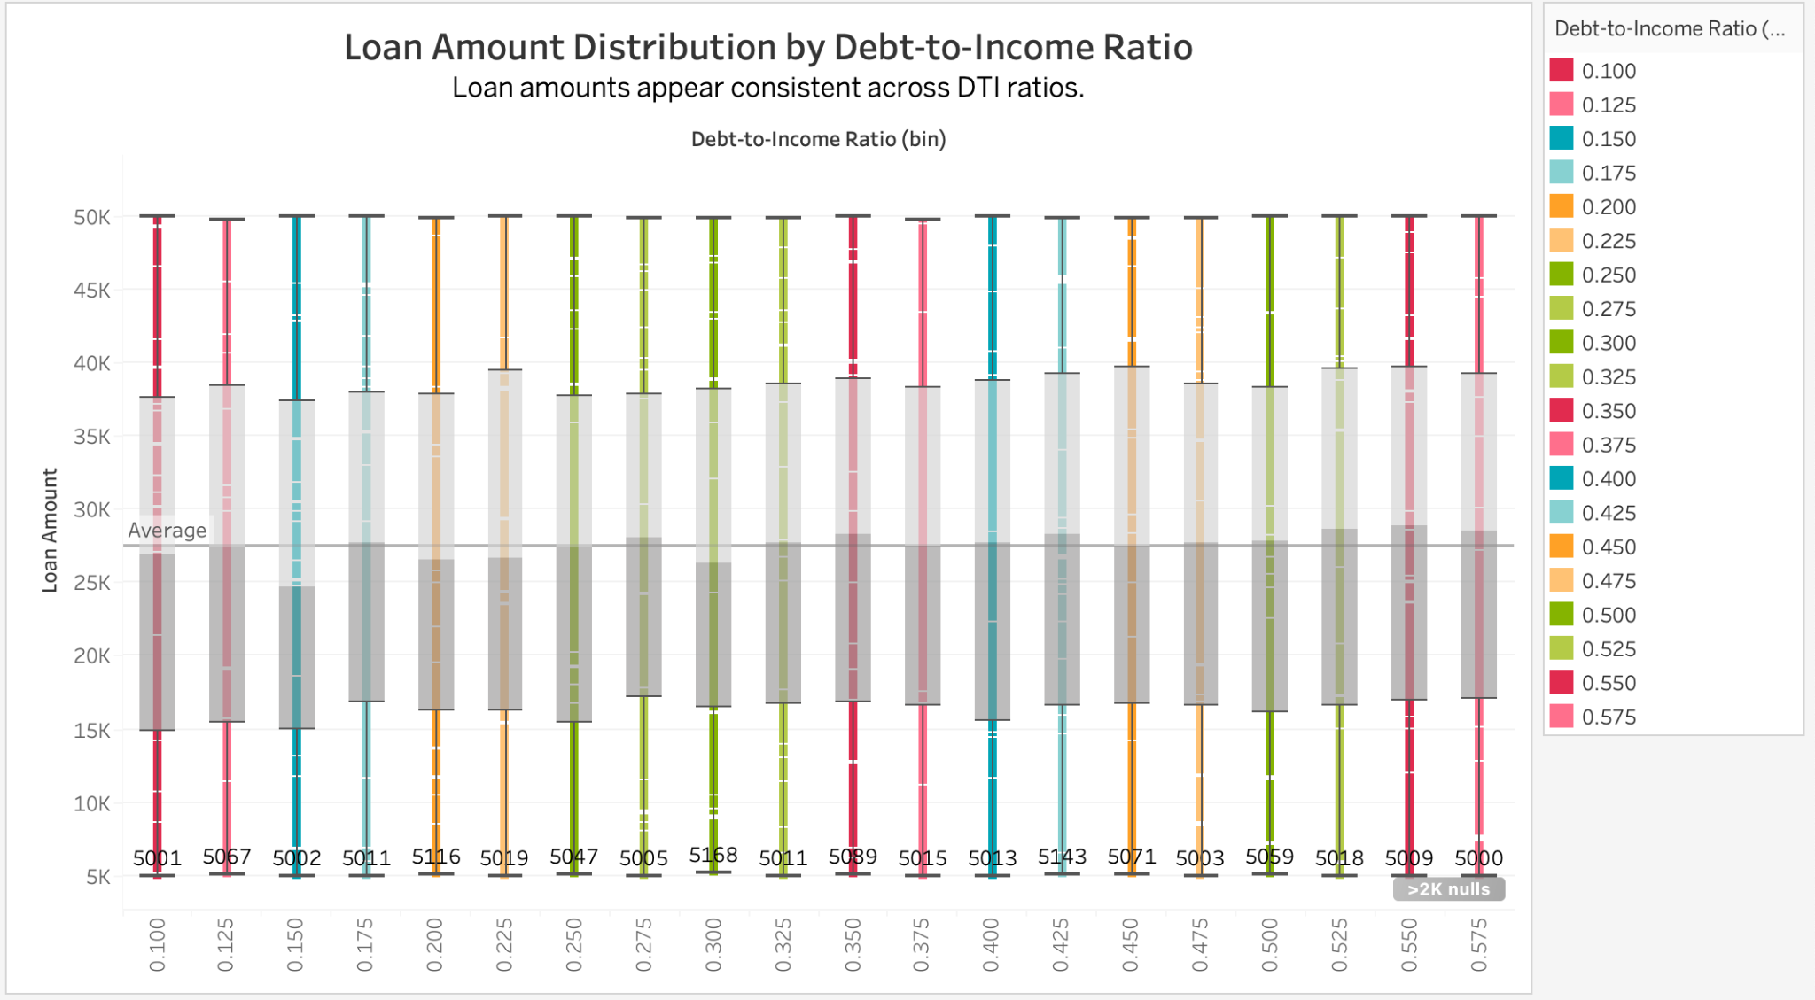
Debt-to-Income (DTI) Ratio
A linear regression analysis was performed to assess whether DTI predicts loan amount. While the p-value was statistically significant (p = 0.0015), the R² value was just 0.0008, indicating that DTI explains less than 0.1% of the variation in loan size.
The accompanying box plot visualization confirms this, showing a flat and overlapping distribution of loan amounts across DTI bins — with no clear trend or outliers that would suggest a strong relationship.
This result highlights an important distinction: statistical significance does not imply practical relevance. In this case, although DTI passes a significance test, it has virtually no predictive power when it comes to explaining how much a borrower receives.

Slide 9
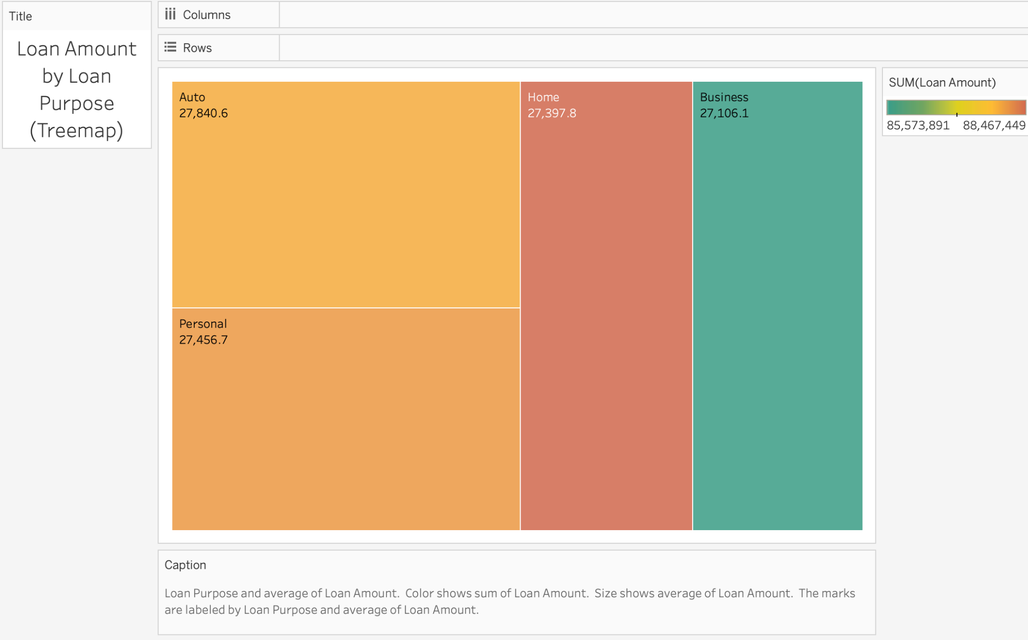
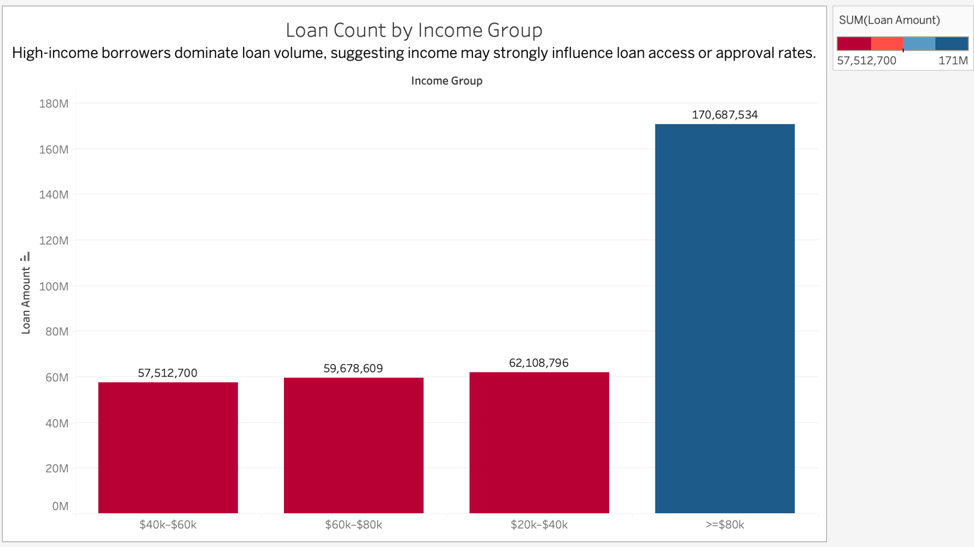
Income Group & Purpose
High-income borrowers accounted for a larger share of total loan volume, but their average loan amounts were nearly identical to those of middle- and low-income groups. This suggests income influences how often loans are approved, not how much is lent.
Similarly, loan size did not vary significantly across loan purposes. Whether the loan was for a personal need, vehicle, home, or business, the average disbursement stayed consistent in the $27K–$28K range. This suggests consistent lending standards regardless of purpose
Both the bar chart and treemap reinforce the same conclusion: higher-income individuals received a greater number of loans, but not larger ones. The average loan size remained consistent across all income levels, indicating that income influenced loan volume rather than loan value. Similarly, loan purpose did not appear to affect loan amounts — average loan sizes were nearly identical across categories such as Auto, Personal, Home, and Business, suggesting no strong trend or bias based on how the funds were intended to be used.

Slide 10
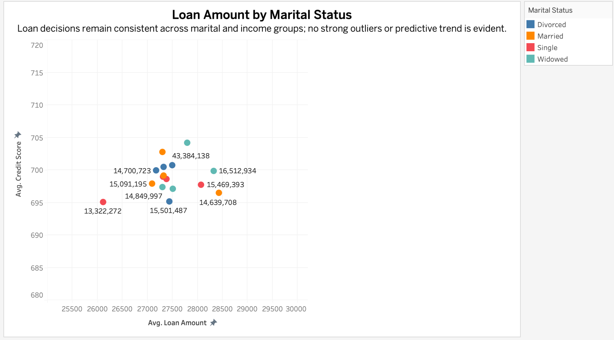
Loan Amount by Marital Status
Loan approval decisions appear consistent across marital statuses. The scatterplot shows that average loan amounts and credit scores are relatively uniform for all groups—Married, Single, Divorced, and Widowed. No particular group consistently received higher or lower loan amounts, and no strong relationship exists between marital status and creditworthiness. Even when disaggregated by income, loan sizes remained clustered, with no group showing a significant deviation. This suggests that marital status did not meaningfully influence loan decisions in either amount or approval behavior.

Slide 11
Next Steps & Recommendations
Step 1
Build a multivariate regression or ML model to combine borrower attributes
Step 2
Investigate approval/denial policy data for deeper insight
Step 3
Enrich dataset with loan term, collateral, or purpose to improve predictive power
Step 4
Divide borrowers into groups based on credit risk to assess attribute impact within credit bands

